Slide 1
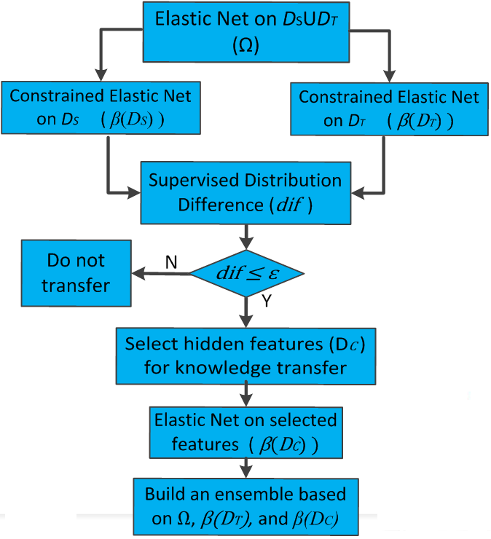
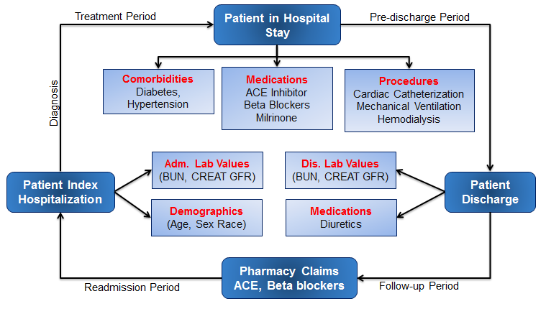
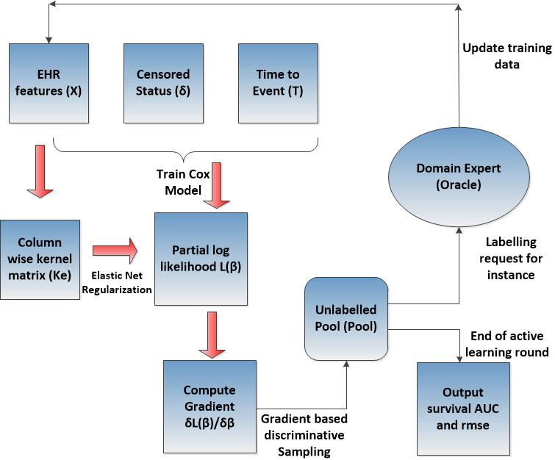
Rehospitalization Analytics: Modeling and Reducing the Risks of Rehospitalization
PI: Chandan K. Reddy, Dept. of Computer Science, Wayne State Univ.
NSF Award #1231742 (10/01/2012 – 09/30/2015)
PROBLEM MOTIVATION
TIME-TO-EVENT PREDICTION
KNOWLEDGE TRANSFER
PROJECT TEAM
Hospitalizations account for more than 30% of the 2 trillion annual cost of healthcare in the US.
As many as 20% of all hospital admissions occur within 30 days of a previous discharge. Such rehospitalizations are not only expensive but are also potentially harmful, and most importantly, they are often preventable.
Identifying patients at the risk of rehospitalization can guide efficient resource utilization and is a cost-effective measure that can save millions of healthcare dollars each year.
Commonly used models such as linear and logistic regression cannot handle non-negative outcome variables and censoring directly.
Cox regression is one of the most popular and widely used survival regression methods which can predict hazard probabilities at any particular time without retraining the model.
Survival analysis deals with the prediction of time to event. Survival time is usually measured till the occurrence of an event of interest such as heart failure readmission.
Regularized Cox Regression helps in building robust survival regression models with more generalizability.
347 million people worldwide have diabetes. 25.8 million Americans have diabetes. Total costs of diagnosed diabetes in U.S. is $245 billion in 2012.
Early and accurate detection of diabetes is a complex problem since the local data is not sufficient and global data contains multiple population groups.
Developed new transfer learning method based on constrained elastic net.
The proposed model can transfer the useful knowledge from different population groups data and make accurate predictions in the presence of limited amounts of health data.
Principal Investigator:
Chandan K. Reddy
Collaborators:
David Lanfear, Badri Padhukasahasram
(Henry Ford Health System)
Graduate Students:
Bhanu Vinzamuri, Mahtab Fard, Yan Li
Martin Alther
Project URL:
http://www.cs.wayne.edu/~reddy/projects/health/
OUTREACH ACTIVITIES
Editors: Chandan K. Reddy and Charu Aggarwal
Healthcare Data Analytics
760 pages, 21 chapters
CRC Press, June 2015.
PROJECT GOALS
Build novel computational models to effectively predict the rehospitalization risk using patients’ electronic health records.
Integrating multiple heterogeneous clinical data sources about the patients.
Knowledge transfer between healthcare datasets with different population groups.
﻿Develop new methods that can extract the overall significant and population-specific risk factors effectively even in the presence of several correlations in the data.
FRAMEWORK FLOWCHART
OUR CONTRIBUTIONS
Special issue on Intelligent Systems for Healthcare in the ACM Transactions on Intelligent Systems and Technology, 2014.
TUTORIAL: “Big Data Analytics for Healthcare”@ KDD2013 and SDM2013.
Kernel elastic net (KEN-COX)
Can capture correlation more effectively than the elastic net.
Octogonal Shrinkange Clustering (OSCAR-COX)
To handle grouped sparsity in the EHR.
Active Regularized Cox Regression
An active learning based survival prediction algorithm using model discriminative gradient based sampling.
SELECTED PUBLICATIONS
B. Vinzamuri and C. K. Reddy, "Cox Regression with Correlation based Regularization for Electronic Health Records", IEEE International Conference on Data Mining (ICDM), 757-766, 2013.
B. Padhukasahasram, C. K. Reddy, Y. Li, and D. E. Lanfear, "Joint Impact of Clinical and Behavioral Variables on the Risk of Unplanned Readmission and Death after a Heart Failure Hospitalization", PLoS ONE, 10(6), e0129553, June 2015.
B. Vinzamuri, Y. Li and C. K. Reddy, "Active Learning Based Survival Regression for Censored Data", In Proceedings of the ACM Conference on Information and Knowledge Management (CIKM), 241-250, November 2014.
Y. Li, B. Vinzamuri, and C. K. Reddy, "Constrained Elastic Net based Knowledge Transfer for Healthcare Information Exchange", Data Mining and Knowledge Discovery (DMKD), 29(4): 1094-1112, July 2015.
REHOSPITALIZATION CYCLE
FRAMEWORK FLOWCHART
PRESERVING PATIENT PRIVACY
Hospitals are EXTREMELY cautious and concerned about patient privacy.
Data collected from different Healthcare facilities is not only distributed across multiple locations but also has different data distribution.
Developed accurate predictive models without revealing the actual patient information from other facilities.
CONTACT
reddy@cs.wayne.edu
http://www.cs.wayne.edu/~reddy

